Slide 1
PRODUCT RECEIPT
Team – Aakash
Dileep Sahu
Kuntal Dinda

Slide 2
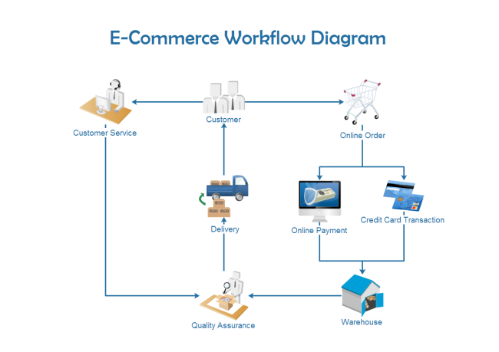

Slide 3
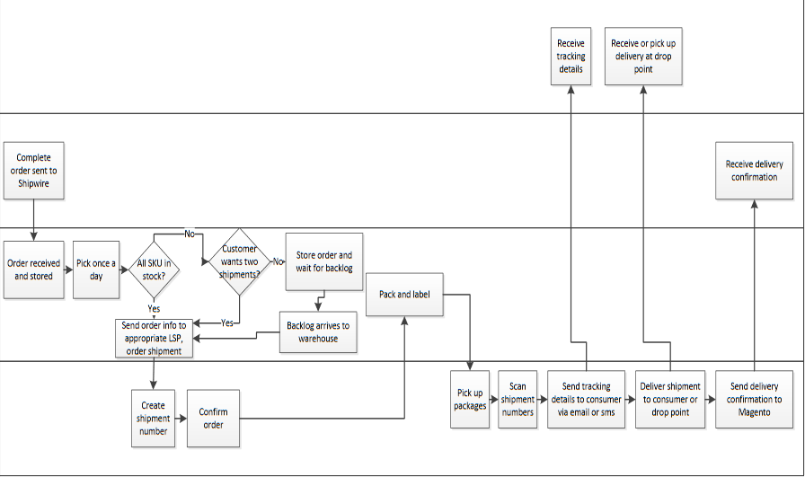

Slide 4

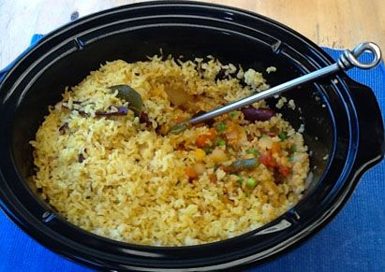
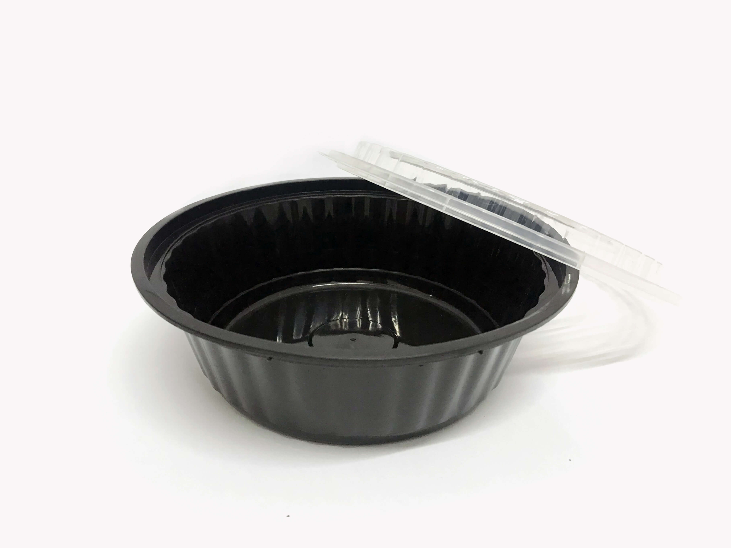
Challenges in food industry(Zomato,Food Panda,Swizzy,UberEats)
Poor quality food is delivered (Non branded food delivered)
Insufficient(less) quantity is delivered
Difficult to substantiate refund case
Container quantity detection

Slide 5

Challenges in Online grocery(Grofers,Big Basket)
Difficult to acknowledge the number& quantity of products ordered
Missing packets and missing items

Slide 6


Challenges in online shopping
Blank box
Defected/damaged product
Old/used product
Different item
Difficult to detect the culprit (vendor /delivery boy/customer)
Could be an addition to vendor rating

Slide 7

Solution
Vendor
Product
Rating
Order
Customer
Platform
Integrator
Feedback
Feedback

